Slide 1
Week 6-7

Slide 2
Literature Review
R. Karthiga, C. L. B. Devi, R. Janaki, C. Gayathri, V. S. Pandi and D. Shobana, "IoT Farm: A Robust Methodology Design to Support Smart Agricultural System Using Internet of Things with Intelligent Sensors Association," 2023 7th International Conference on Electronics, Communication and Aerospace Technology (ICECA), Coimbatore, India, 2023, pp. 1332-1337, doi: 10.1109/ICECA58529.2023.10395635.
Abstract: The term “Smart Farming” has been increasingly popular in recent years due, in large part, to the proliferation of network-based, high-tech farm monitoring cycles. These cycles make extensive use of technologies for communication and information gathering in the form of machinery, equipment, and sensors. The Internet of Things, often known as IoT, is the wave of the future in every sector of the economy, and its impacts will be felt by everyone. It is a collection of different devices that are capable of configuring themselves into a fully operational network. Conventional farming practices are progressively being supplanted by smart farming, which takes use of advancements made possible by the internet of things. This makes conventional farming methods more efficient, which in turn saves farmers money and reduces the amount of food that is lost. This technology helps farmers conserve energy and time by evaluating data in actual time from sensors placed in crops and offering actionable information on how their crops are progressing. The data comes from the sensors themselves, which are planted in the crops. Data from the field is sent to the cloud and evaluated there so that procedures may be automated utilizing Internet of Things devices. The assessment of the farmer's contribution into the process of making choices is demonstrated with information regarding the temperature of the field, the soil moisture level, the humidity level, and the amount of water that is used. In addition, the technical knowledge presented here is valuable to producers at every stage of the production process, including planting, growing, harvesting, packaging and shipping.
keywords: {Smart agriculture;Temperature sensors;Soil moisture;Crops;Internet of Things;Intelligent sensors;Farming;Agriculture;IoT Farm;Smart Farming;Internet of Things;IoT;Intelligent Sensors},
URL: https://ieeexplore-ieee-org.ezproxy.auckland.ac.nz/stamp/stamp.jsp?tp=&arnumber=10395635&isnumber=10394681

Slide 3
Literature Review
A. Nurcahyo, H. Soeparno, F. L. Gaol and Y. Arifin, "Developing Smart Precision Farming Using Big Data and Cloud-Based Intelligent Decision Support System," 2023 10th International Conference on ICT for Smart Society (ICISS), Bandung, Indonesia, 2023, pp. 1-6, doi: 10.1109/ICISS59129.2023.10291960.
Abstract: This study discusses the development of smart precision farming systems using big data and cloud-based intelligent decision support systems. Big data plays an important role in collecting, storing, and analyzing large amounts of data from various sources related to agriculture, including data from weather stations, soil sensors, satellite imagery, crop yield records, pest and disease reports, and other sources. This study highlights the differences between smart farming and precision farming. This study describes key techniques and system architecture, including data collection, processing, analysis, and decision support components. Utilizing a cloud platform enables scalability and optimized performance, which lowers costs and makes it safer and easier to manage. The integration of big data and Alibaba cloud computing in smart precision farming can improve farming productivity by providing timely information and recommendations to farmers for better decision-making. Finally, the system produces smart precision farming, which provides cost-effective real-time monitoring and predictive analytics to increase agricultural production and sustainability.
keywords: {Decision support systems;Smart agriculture;Productivity;Cloud computing;Systems architecture;Big Data;Soil;smart farming;precision farming;intelligent agent;decision support system;big data;cloud computing},
URL: https://ieeexplore-ieee-org.ezproxy.auckland.ac.nz/stamp/stamp.jsp?tp=&arnumber=10291960&isnumber=10291186

Slide 4
Literature Review
[1] Rahman, M., Kohinoor, M. S. R., & Sami, A. A. (2023). Enhancing Poultry Farm Productivity Using IoT-Based Smart Farming Automation System. In Proceedings of the 26th International Conference on Computer and Information Technology (ICCIT) (pp. 1-6). Cox's Bazar, Bangladesh. IEEE. https://doi.org/10.1109/ICCIT60459.2023.10441525
[2] Demilie, W. B. (2024). Plant disease detection and classification techniques: A comparative study of the performances. Journal of Big Data, 11(5). https://doi.org/10.1186/s40537-023-00863-9
[3] Pangilinan, J. R., Legaspi, J., & Linsangan, N. (2022). InceptionV3, ResNet50, and VGG19 performance comparison on tomato ripeness classification. In Proceedings of the 5th International Seminar on Research of Information Technology and Intelligent Systems (ISRITI) (pp. 619-624). Yogyakarta, Indonesia. IEEE. https://doi.org/10.1109/ISRITI56927.2022.10052920

Slide 5
Literature Review
[4] Nourbakhsh, A., Mehrabani, E. B., Faraji, S., Shirazi, F. A., & Hatefi, M. (2023). Tomato ripeness evaluation and localization using Mask R-CNN and DBSCAN clustering. In Proceedings of the 11th RSI International Conference on Robotics and Mechatronics (ICRoM) (pp. 714-719). Tehran, Iran, Islamic Republic of. IEEE. https://doi.org/10.1109/ICRoM60803.2023.10412430
[5] Chukkapalli, S. S. L., et al. (2020). Ontologies and artificial intelligence systems for the cooperative smart farming ecosystem. IEEE Access, 8, 164045-164064. https://doi.org/10.1109/ACCESS.2020.3022763

Slide 6
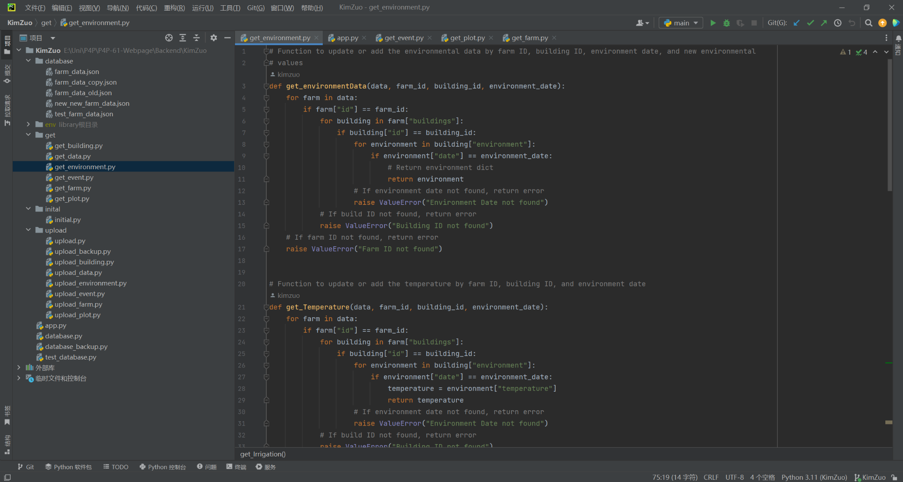
Server Get Method

Slide 7
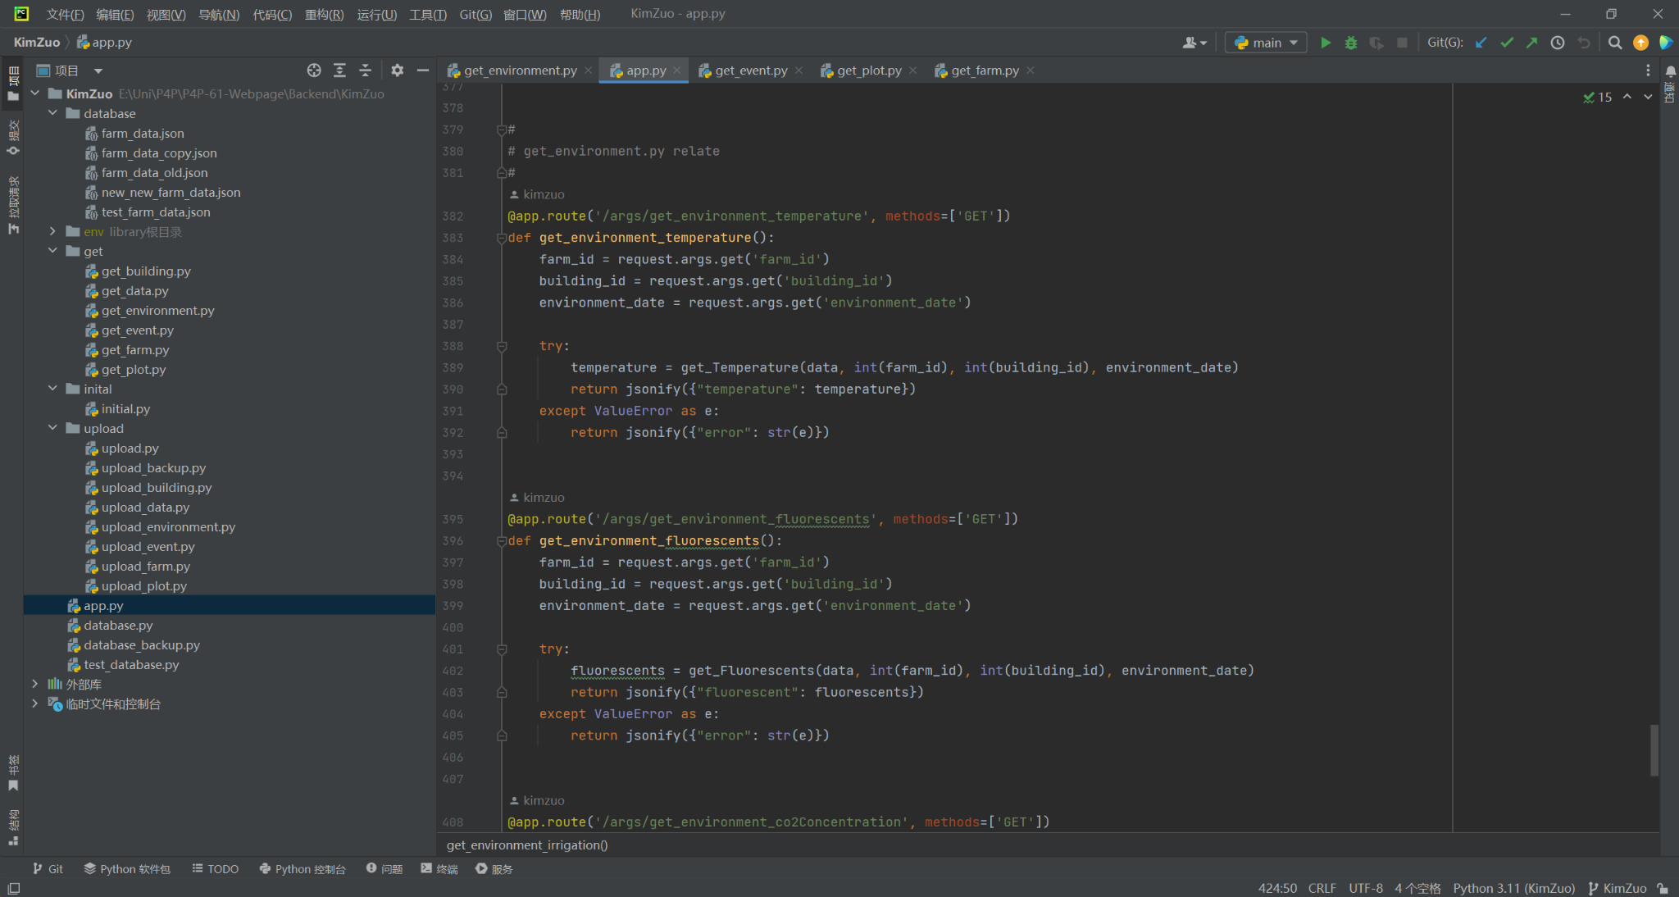
Server Get Method

Slide 8
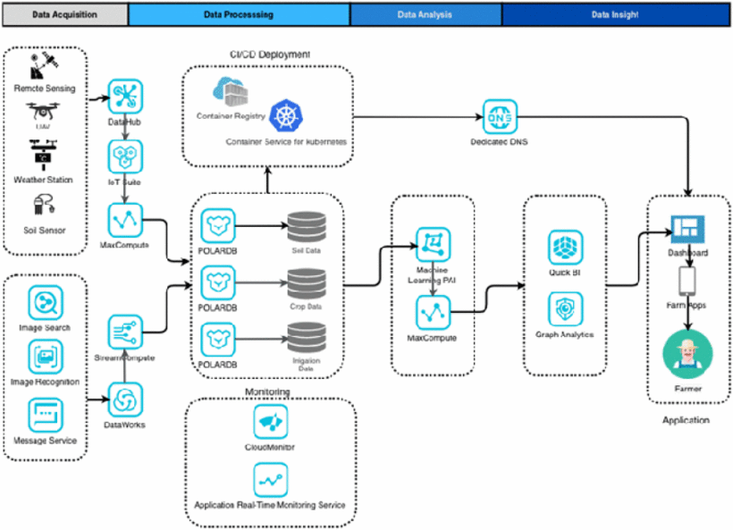
Literature Review

Slide 9
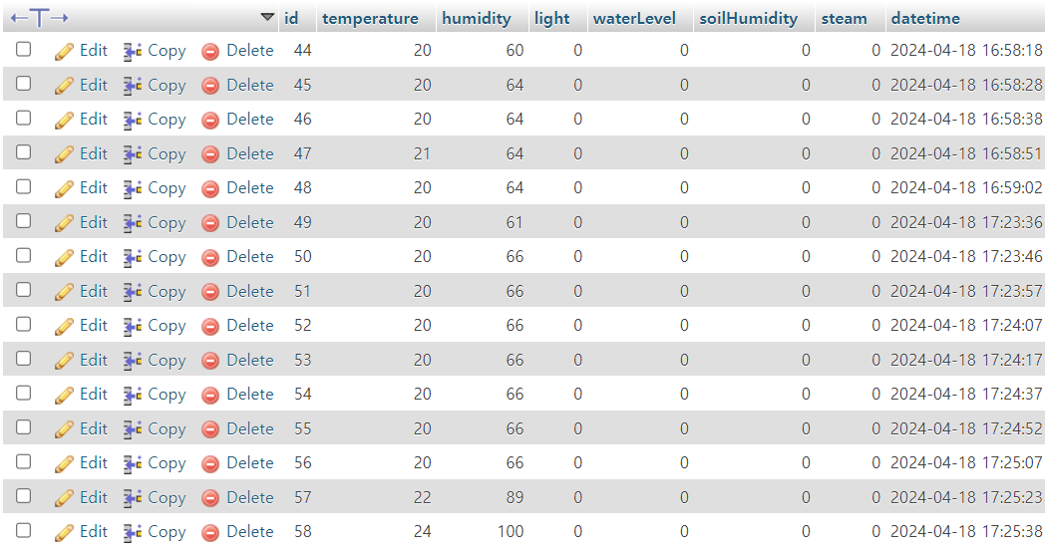
IOT sensor
The temperature and humidity sensor with ESP32 board send data every 10 seconds and it will save in MySQL.

Slide 10
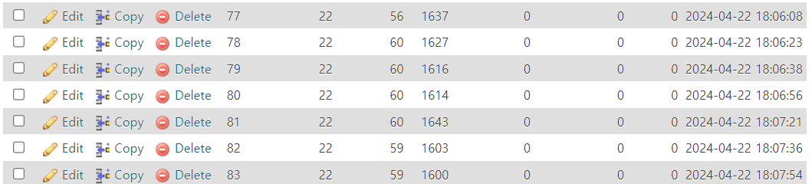
IOT sensor
Data(Temperature, Humidity, Light) send to MySQL through HTTP.

